Slide 1
Java Generic

Slide 2
Java programation generic
Generic programming aims to facilitate the development of algorithms (or methods in OOP) in such a way that the specific data type manipulated by the algorithm is specified at the time the algorithm is executed and not at the time the algorithm is developed.

Slide 3
why use generic programming?
simpler coding
code reuse in numerous scenarios
error checking at compile time

Slide 4
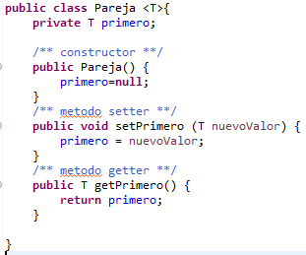
create a generic class
a generic class is declared
the parameter <T> indicates that it can receive data of any type.
by convention the letters T, U and K are used.

Slide 5
Herence generic
Generic classes cannot inherit
here is an example where inheritance is not possible

